Slide 1













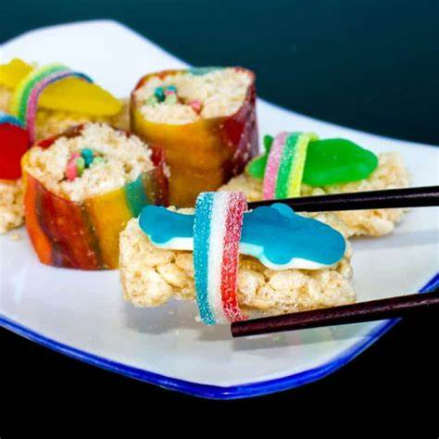
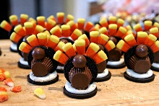
Activities for November Sunday 19th - Saturday 25th
SUNDAY | MONDAY | TUESDAY | WEDNESDAY | THURSDAY | FRIDAY | SATURDAY
9am – 10am Bagel Bar Whole bagel $4/ half of bagel $2 with orange juice or coffee | 9am Morning Walk Join us for a morning walk. Meet in the Canyon Room | 9am Morning Walk Join us for a morning walk. Meet in the Canyon Room | 9:30am Morning BINGO Grab a cup of coffee and play some BINGO $1 each card | Tennis Courts Hours 7am-8pm Please Sign up at front desk | 9:30am Hot Chocolate Stand Stop by the Canyon room and grab a yummy hot chocolate $2 a cup | 9am – 10am Wake Up Waffles Come to the Canyon Room and enjoy a delicious waffles Set of waffles $4 with coffee or orange juice.
11am Water Aerobics Meet at pool #4 for a water workout | 11am Water Aerobics Meet at pool #4 for a water workout | 12pm BINGO Meet us in the Canyon Room for BINGO. $1 each card | 1:30pm – 3:30pm Nintendo switch FREE play In the canyon room |  | 11pm BINGO Grab a cup of coffee and play some BINGO $1 each card | 12pm – 1pm Nacho Lunch In Nacho cheese and jalapenos. $5
1:30pm – 2:30pm Ice Cream Social sundaes $5 / root beer floats $4 Meet In the Canyon room | 12:15pm BINGO Meet us in the Canyon room for BINGO. $1 each card | 2pm – 3pm Ice Cream Social sundaes $5 / root beer floats $4 Meet In the Canyon room | 3:30pm Movie Night Purchase a movie ticket that includes a snack combo. Movie starts at 4pm. |  | 2pm – 3pm Ice Cream social sundaes $5 / root beer floats $4 Meet In the Canyon room | 2pm BINGO Grab a cup of coffee and play some BINGO $1 each card
3:30pm Thanksgiving Trivia Come to the Canyon Room and see if you can win our trivia | 2pm – 3pm Ice Cream Social sundaes $5 / root beer floats $4 Meet In the Canyon room |  | Children Must be accompanied by an adult for all Activity |  | 4pm Kids Sushi Come and make a delicious sushi roll using candy ONLY! | 3pm Oreo Turkey Cookie edible turkey craft that kids and adult will love $5
Coffee & Tea served daily from 6am – 10am in the Canyon Room

